Slide 1

Stock Price Prediction
using Machine Learning
Submitted By : - M.C.A. (Regular Entry) Semester-VI
Preyash S. KaPatel (18034211003)
Guided by
Dr. Jigneshkumar A. Chauhan (Internal Guide)
Submitted to Acharya Motibhai Patel Institute of Computer Studies,
GANPAT UNIVERSITY
Dec-April 2021

Slide 2
Project Profile

Slide 3
Project Profile
Project Title | Stock Price Prediction using Machine Learning
Project category | Web Application
Objective | To Predict the stock price based on the past and upcoming events.
Front End | Django
Back End | Django, Python
Tool | Anaconda, Google Colab
Server | XAMP
Documentation Tool | Office 365
Company Name | MADHDA BUSINESS SOLUTIONS PVT LTD
Internal Guide | Dr. Jigneshkumar A. Chauhan
External Guide | Pravin Dangar
Developed By | Preyash Sanjay KaPatel (1803421003)
Group No | 19

Slide 4
Requirement Specification

Slide 5
Existing system
The existing system works as follow :
Money related transaction require high alertness of statistical insights of history and future events, In such case taking decision of stake sale, hold or buy are difficult.
Before taking decision we need to look at the past data, stock patterns, Recent news and judging the price takes time and it might end up in slow decision, incomplete information.
Taking the Stake sale/buy/Hold based on emotion and incomplete information may perform false prediction.
Drawback of Existing System
Incomplete Information
Emotion based Decision
Unawareness of stock price patterns

Slide 6
Need for new system
Rapid Decision:
User can take decision rapidly as it is performed autonomous.
Improved Accuracy:
User can use the result to take decision for stake sale or hold or buy
Based on Historic data:
Prediction are based on historic data and past events' effect.

Slide 7
Machine Learning Algorithm
Stock price prediction is an important decision in order to gat benefit from stock market.
To predict the stock Price I have used Artificial Neural Network, Which contain three layers:
Input Layer : We have number of features equal to number on neurons in input layer
Hidden Layer : Set of neurons to store what was learned ( can be modified accordingly )
Output Layer : Using only one output layer neuron as we are using it for regression problem.

Slide 8
Machine Learning Algorithm
Creating Indicator Functions is also important to create bias in prediction based on what is more important
Following are the Indicator for Stock Price Prediction:
RSI (Relative Strength Index):
MFI (Money Flow Index)
EMA (Exponential Moving Average)

Slide 9
Machine Learning Algorithm
RSI (Relative Strength Index):
Measures speed and change of price movements.
It ranges in between 0 and 100
We consider overbought above 70 and oversold below 30 (generally)
RSI = 100 – [100 / ( 1 + (Average of Upward Price Change / Average of Downward Price Change ) ) ]

Slide 10
Machine Learning Algorithm
MFI (Money Flow Index):
Related to RSI but incorporates volume too where RSI considers prices only
Typical Price = (High + Low + Close)/3
Next, Money Flow (not the Money Flow Index) is calculated by multiplying the period's Typical Price by the volume.
Money Flow = Typical Price * Volume

Slide 11
Machine Learning Algorithm
EMA (Exponential Moving Average):
SMA = avg of price data,
EMA = more weight to data which is more current.
EMA is more sensitive to price movement and it used to determine trend direction
EMA = (K x (C - P)) + P
where,
C = Current Price
P = Previous periods EMA (A SMA is used for the first periods calculations)
K = Exponential smoothing constant

Slide 12
USED HARDWARE AND SOFTWARE CLINET SIDE
Minimum Requirement of Hardware and Software:
Hardware Requirement:
Basic CPU with 700 MHz Speed
1 GB RAM
Software Requirement:
Chrome with 68.0.3440.75 or above Version
Good Internet Speed

Slide 13
USED HARDWARE AND SOFTWARE Server SIDE
Minimum Requirement of Hardware and Software:
Hardware Requirement:
Inter i3 10th generation
4 GB RAM
250 mb Space in SSD
Software Requirement:
Chrome with 68.0.3440.75 or above Version
High Speed Internet
Google Colab
Webpage IDE
Github Desktop

Slide 14
FUNCTIONAL MODULE SPECIFICATION

Slide 15
Functional Module Specification
Login:
Admin and Account Holder can access website by successfully login
Watchlist:
User can add remove stock from watchlist.
Holdings:
Here user can see there stock holding if they have.
Predictions:
In this module user can predict the stock price.

Slide 16
SYSTEM FLOW CHART

Slide 17
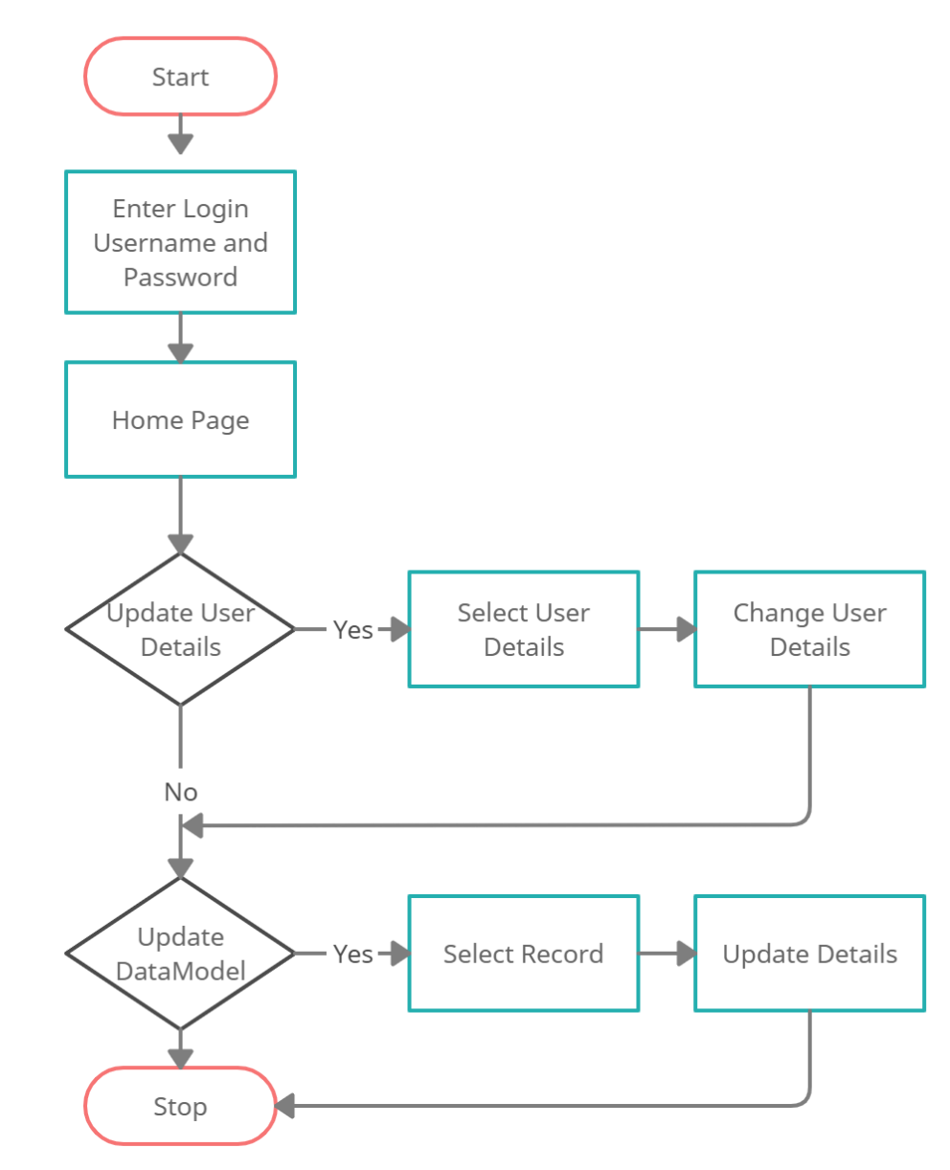
SYSTEM FLOW CHART for Admin

Slide 18
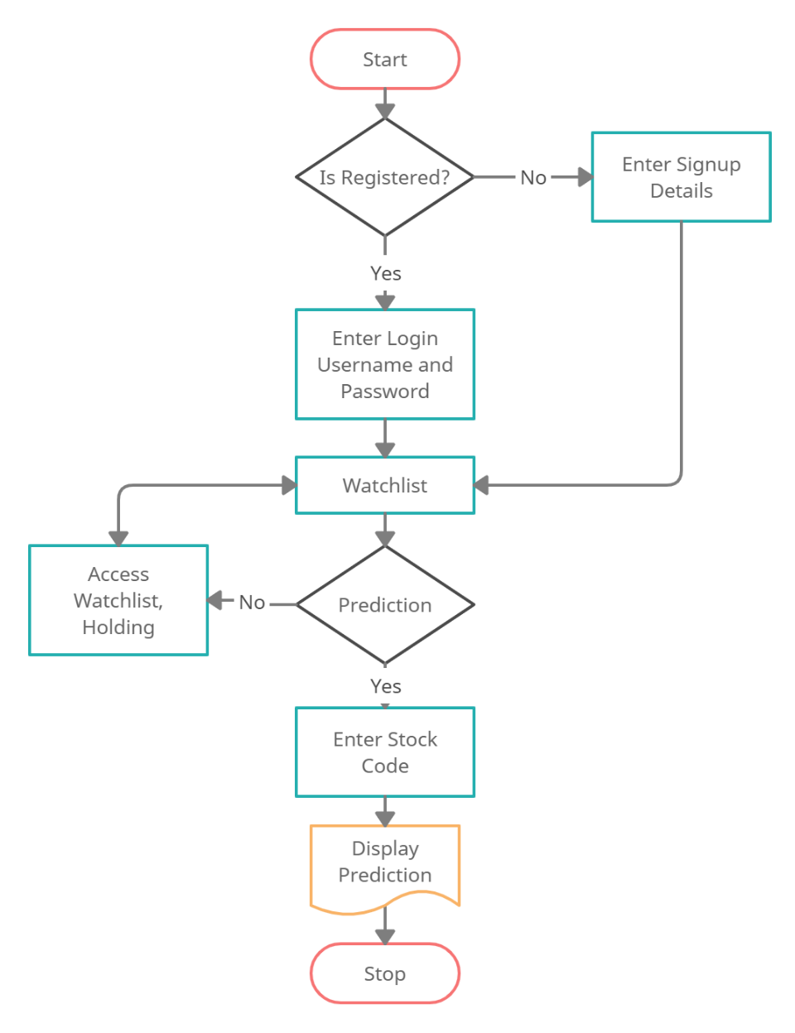
SYSTEM FLOW CHART for User

Slide 19
Use-Case Diagram

Slide 20
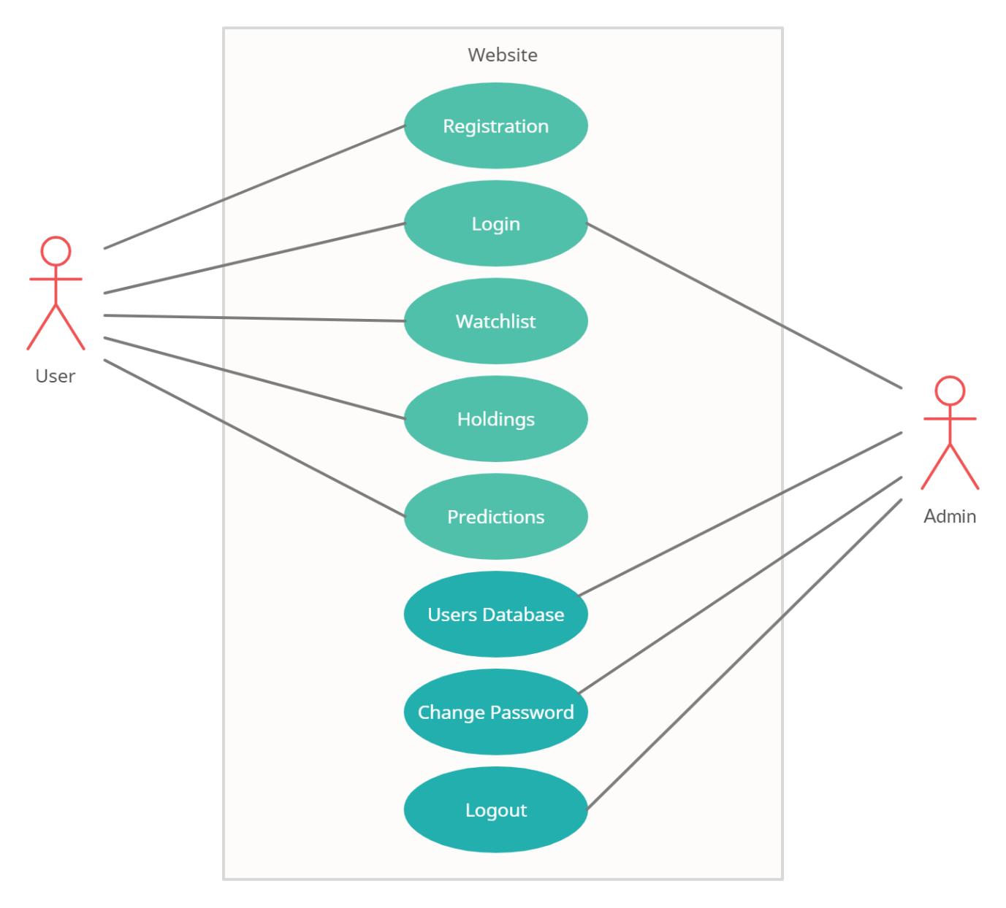
Use-Case Diagram

Slide 21
Class Diagram

Slide 22
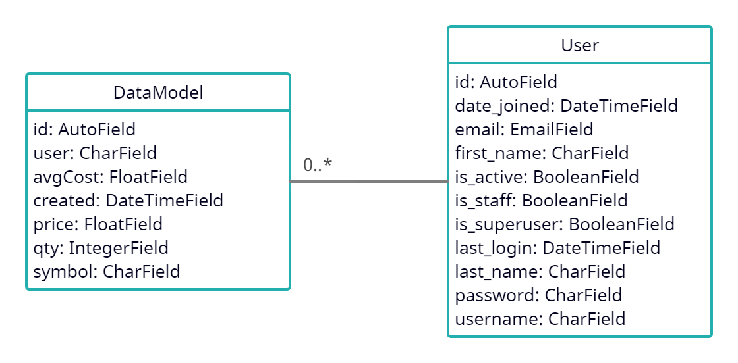
Class Diagram

Slide 23
Sequence Diagram

Slide 24
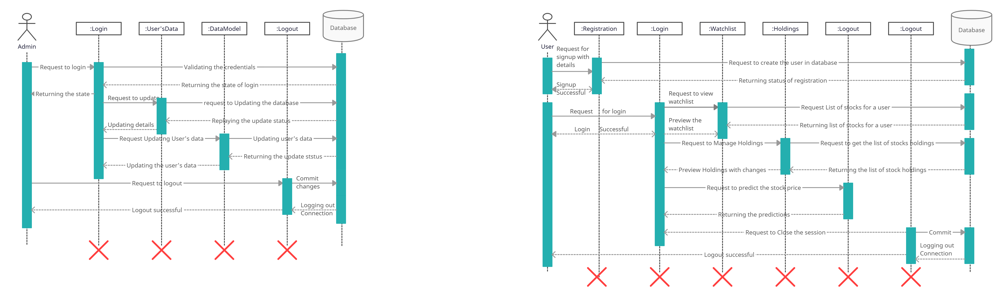
Sequence Diagram for Admin

Slide 25
Sequence Diagram for User

Slide 26
Activity Diagram

Slide 27
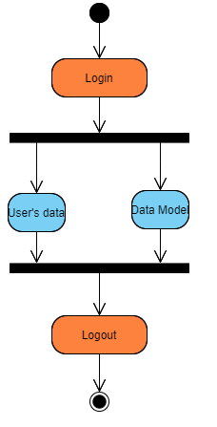
Activity Diagram for Admin

Slide 28
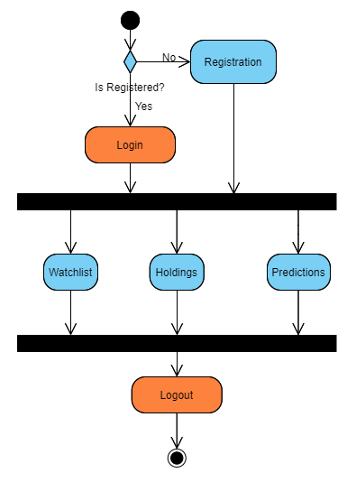
Activity Diagram for User

Slide 29
Deployment Diagram

Slide 30
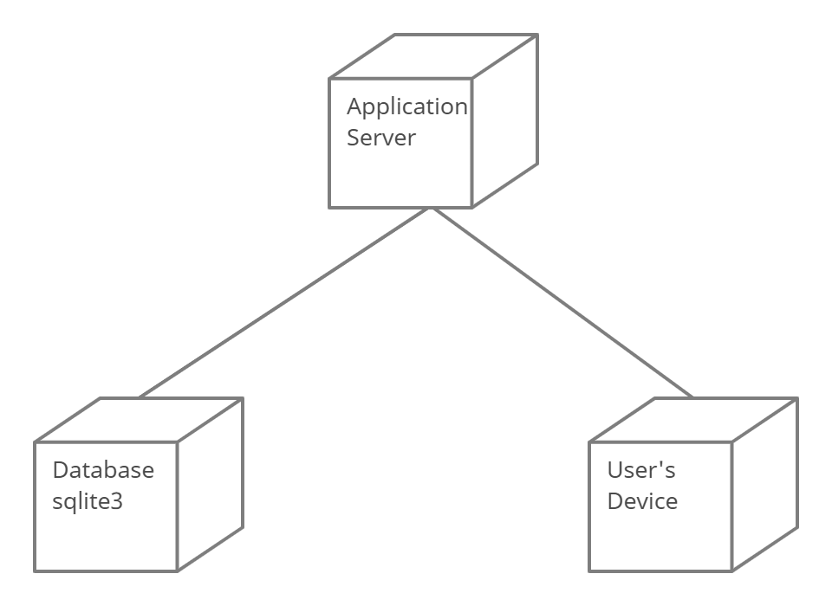
Deployment Diagram

Slide 31
Data Dictionary

Slide 32
Data Dictionary
Name: DataModel
DESCRIPTION :- Represents stock holding and watchlist Primary Key: id
Sr.No | Field Name | Data Type | Constraint | Description
1 | id | IntegerField | Primary Key | Represent Record id
2 | user | CharField | Not Null | Represent registered User
3 | avgCost | FloatField | Not Null | Represent Average cose
4 | created | DateTimeField | Not Null | Represent stock addition date and time
5 | price | FloatField | Not Null | Represent last updated price
6 | qty | IntegerField | Not Null | Represent quenty
7 | symbol | CharField | Not Null | Represent stock symbol

Slide 33
Data Dictionary
Name: User
DESCRIPTION :- Represents users’s details Primary Key: id
Sr.No | Field Name | Data Type | Constraint | Description
1 | id | IntegerField | Primary Key | Represent user id
2 | Date_joined | DateTimeField | Not Null | Represent date of joining
3 | email | EmailField | Not Null | Represent Email id of user
4 | First_name | CharField | Not Null | Represent First Name
5 | Is_active | BooleanField | Not Null | Represent user status
6 | Is_staff | BooleanField | Not Null | Represent user is staff member or not
7 | Is_superuser | BooleanField | Not Null | Represent user is super user or not
8 | last_login | DateTimeField | Not Null | Represent last login date and time
9 | last_name | CharField | Not Null | Represent user’s last name
10 | Password | CharField | Not Null | Represent password
11 | username | CharField | Not Null | Represent username

Slide 34
Input & Output Design

Slide 35
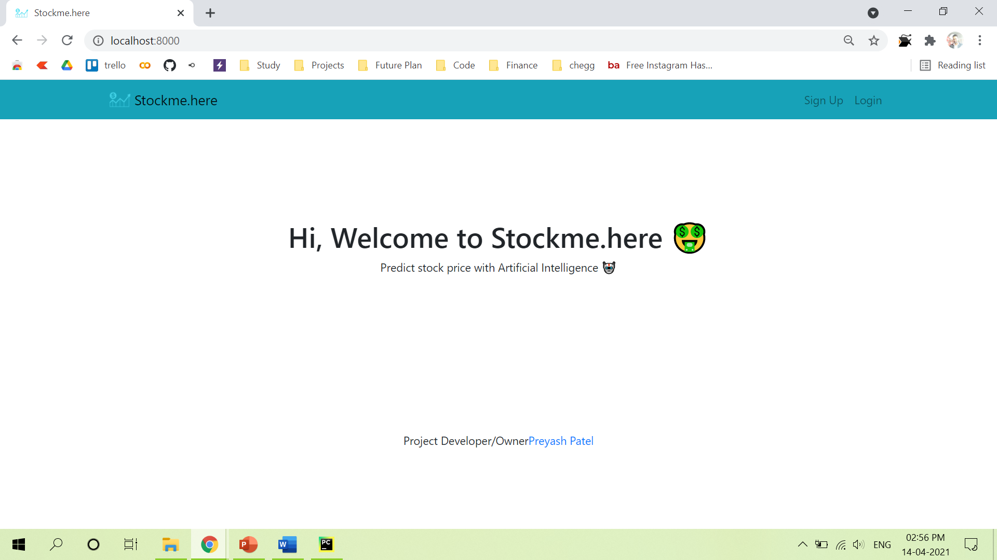
Home Page

Slide 36
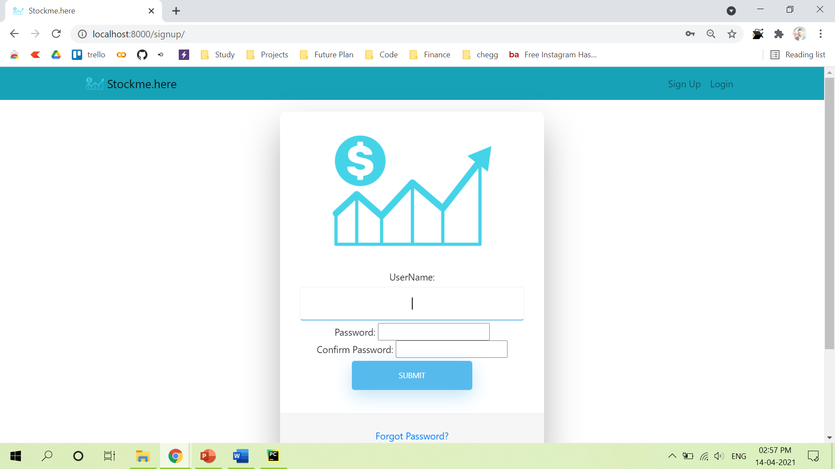
Signup Page

Slide 37
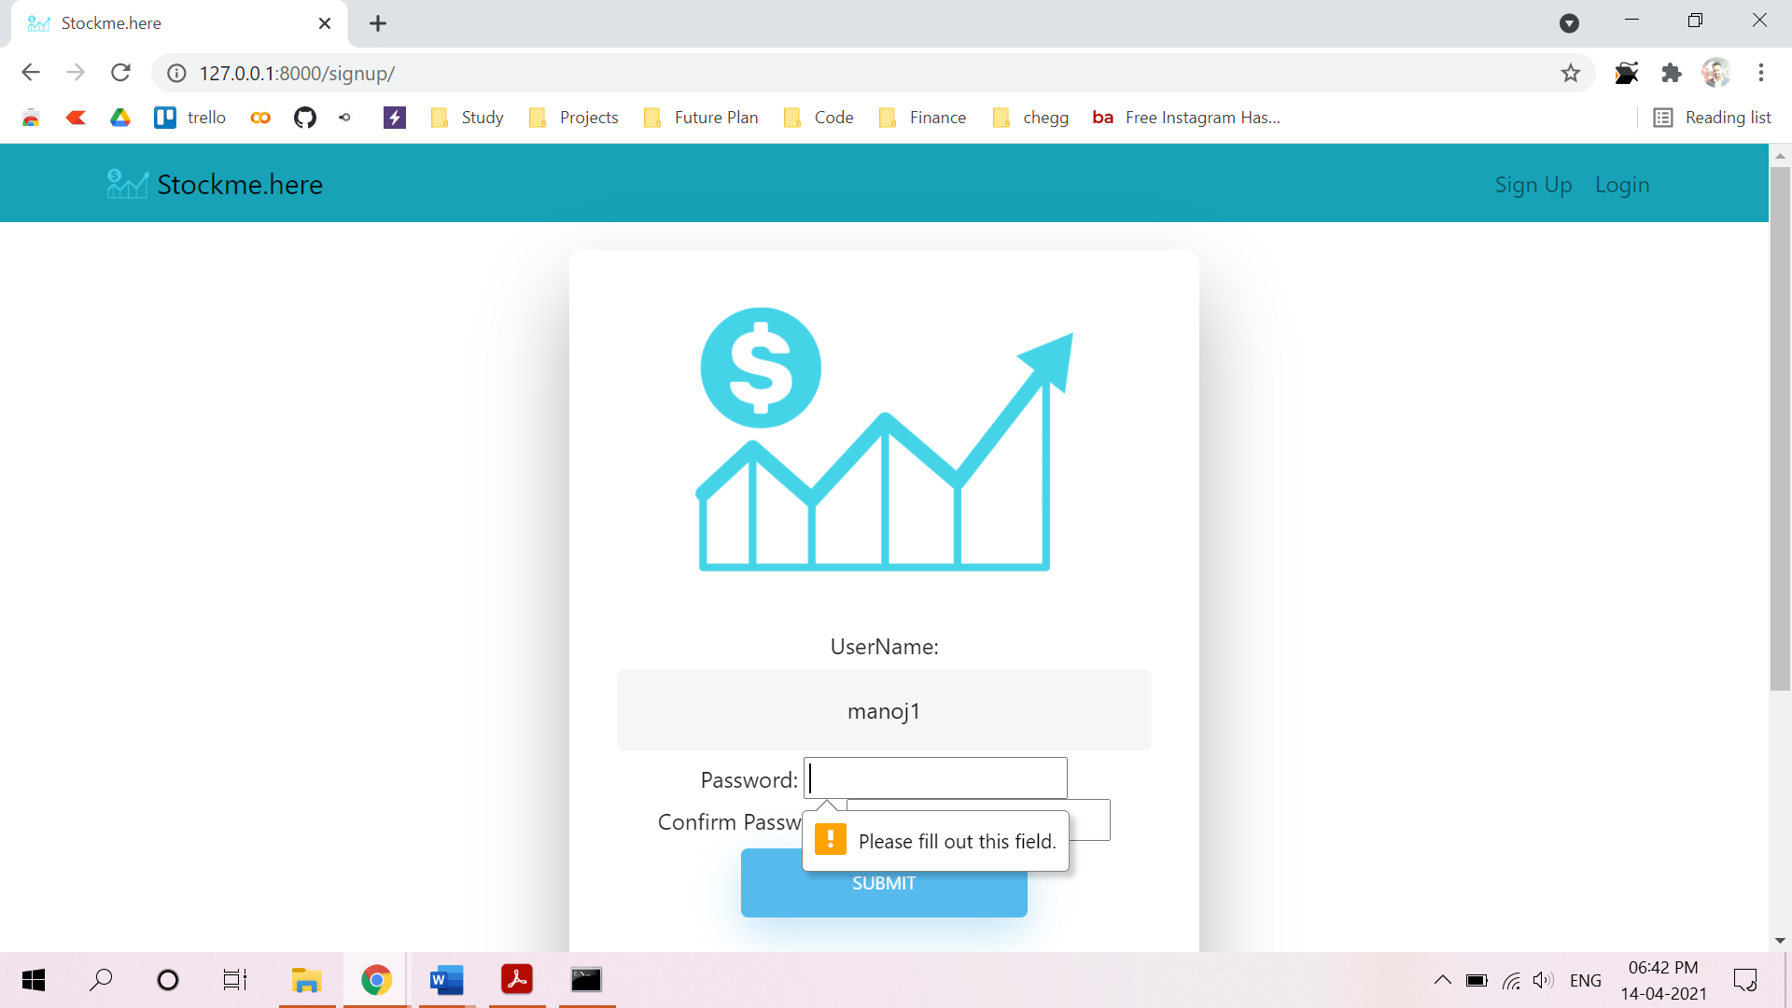
Signup Credential Validation:

Slide 38
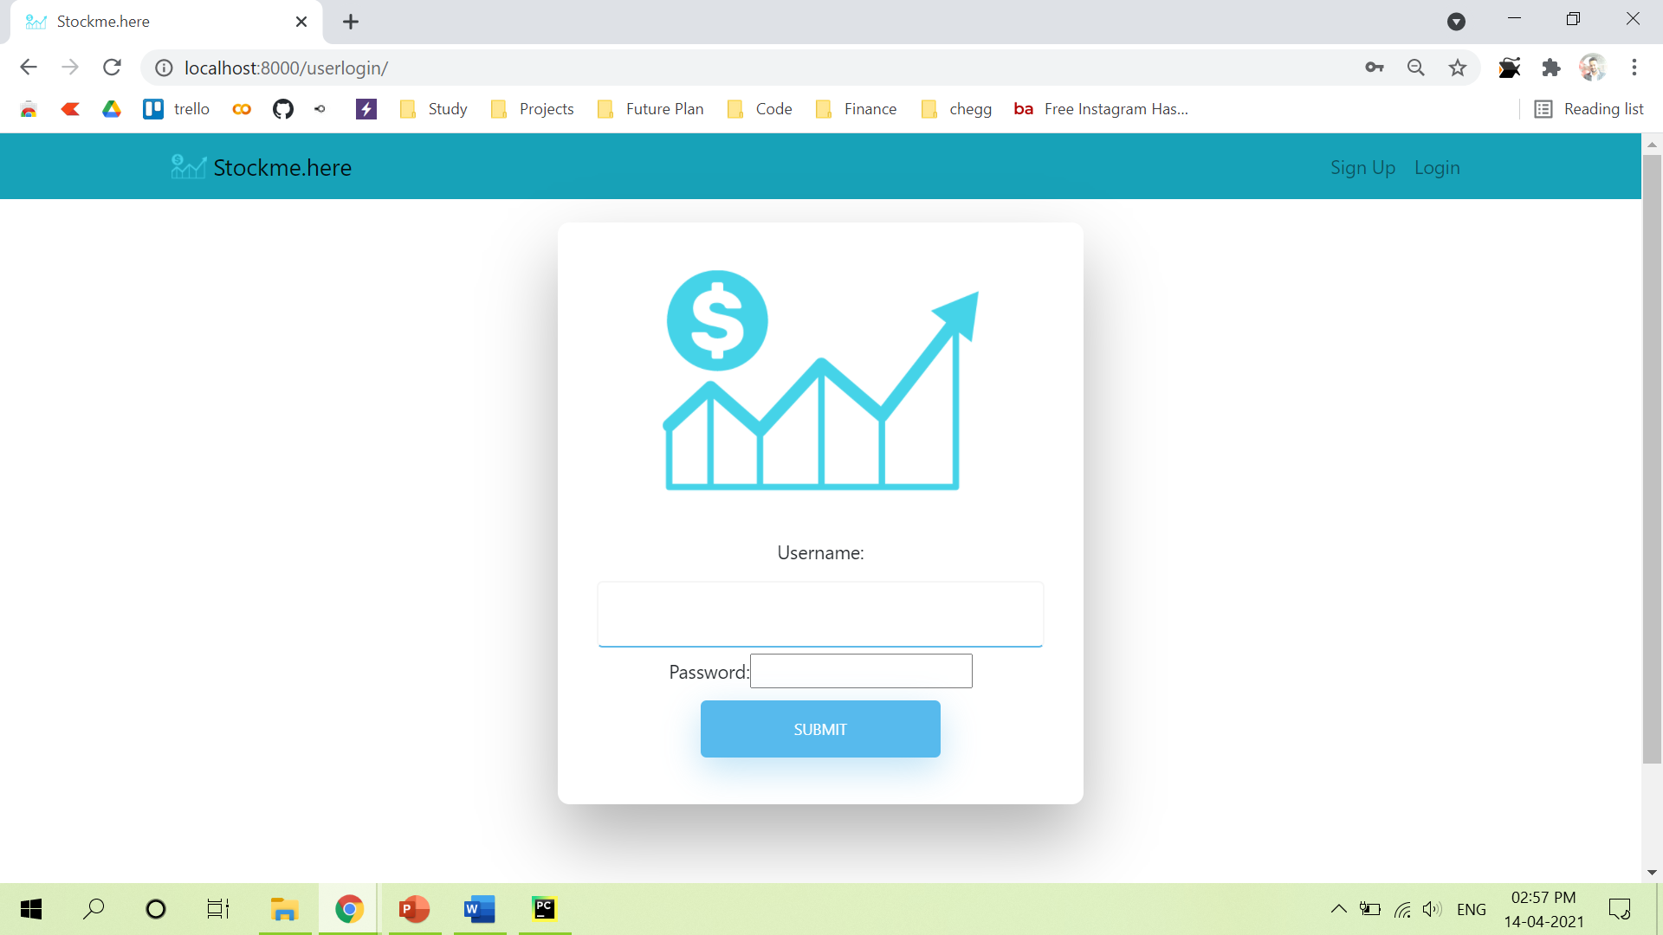
Login Page

Slide 39
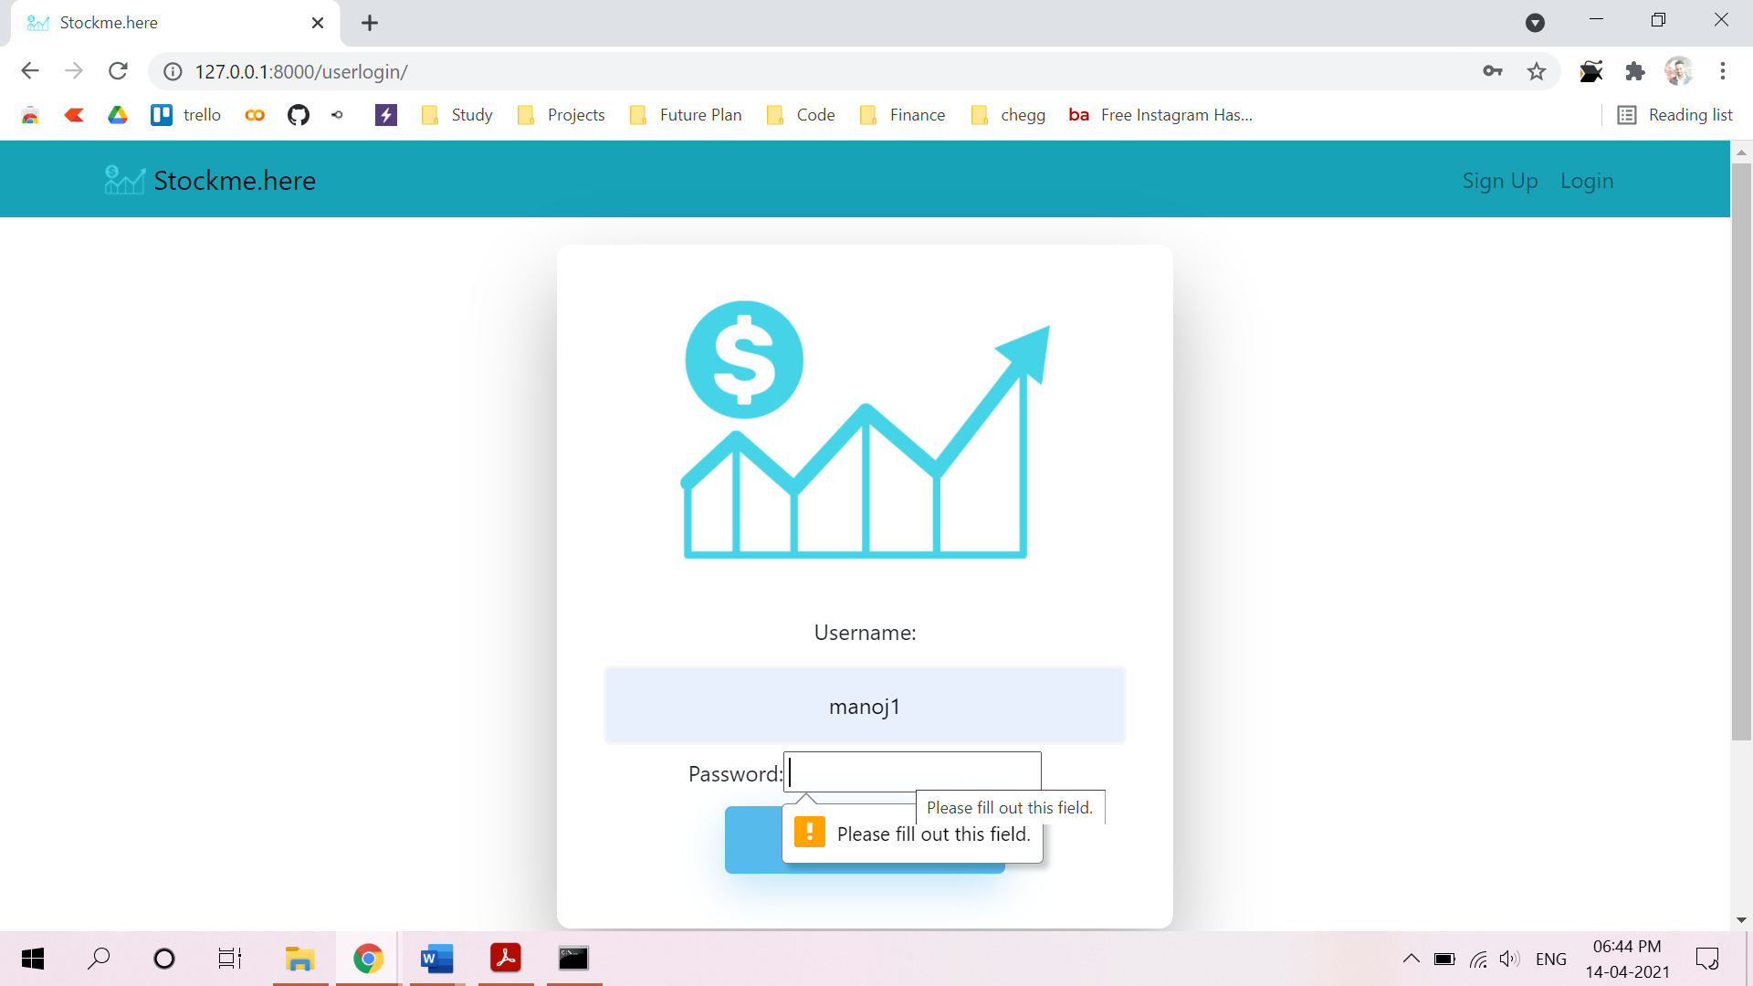
Login Credential Validation:

Slide 40
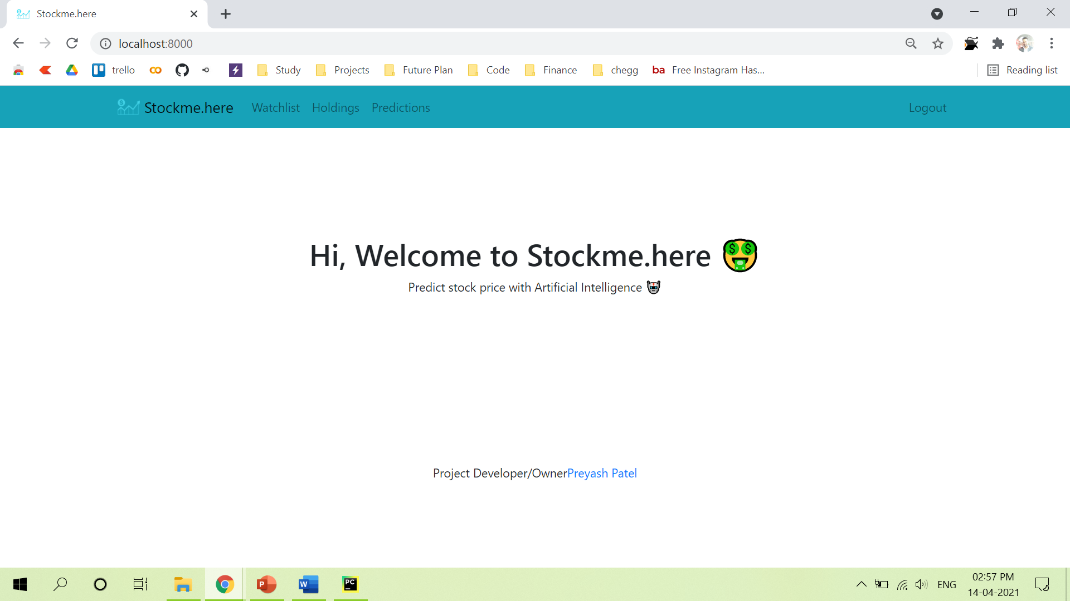
Home after login

Slide 41
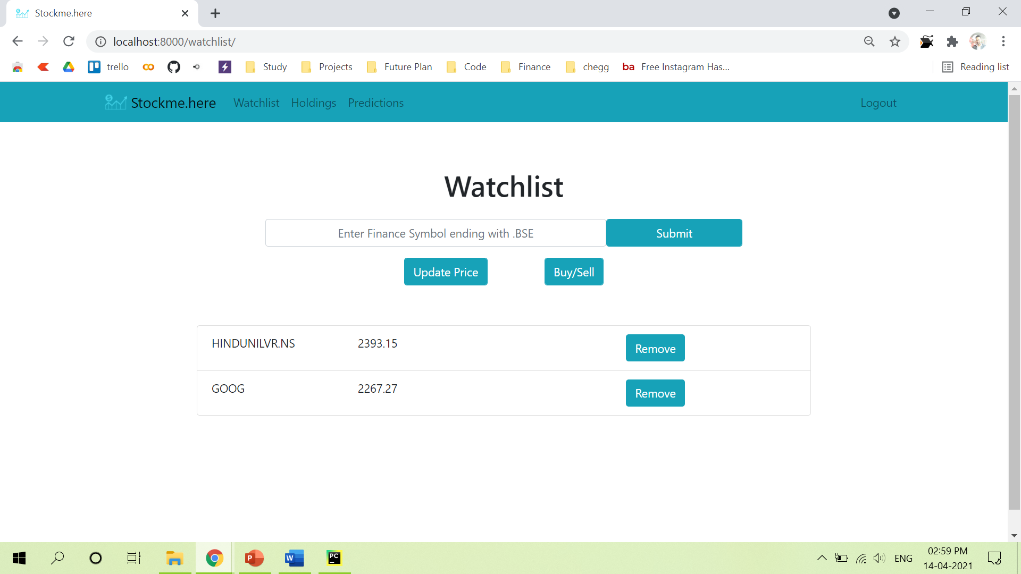
Watchlist Page

Slide 42
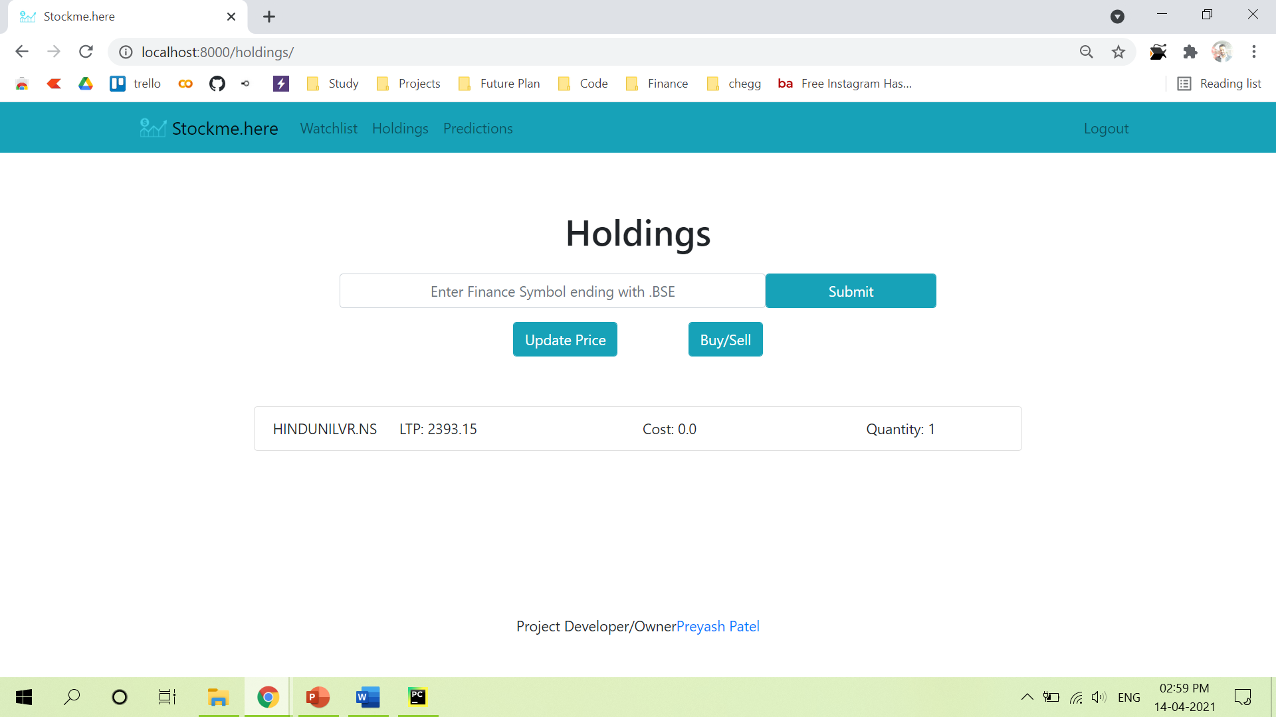
Holdings Page

Slide 43
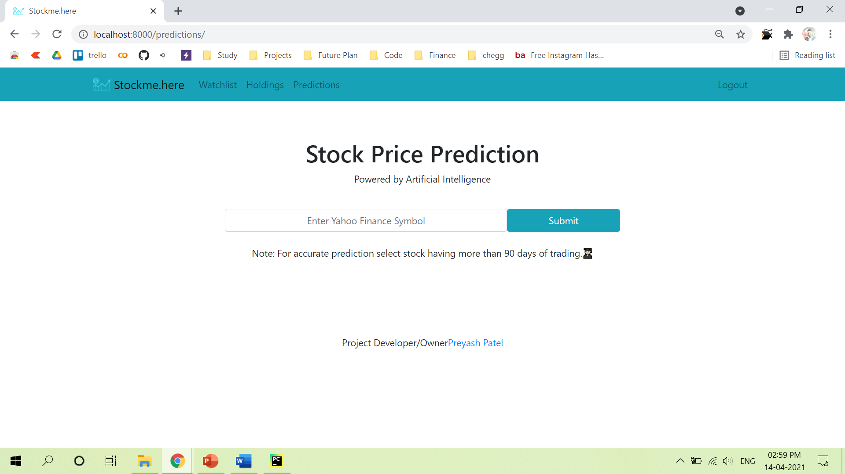
Prediction Page

Slide 44
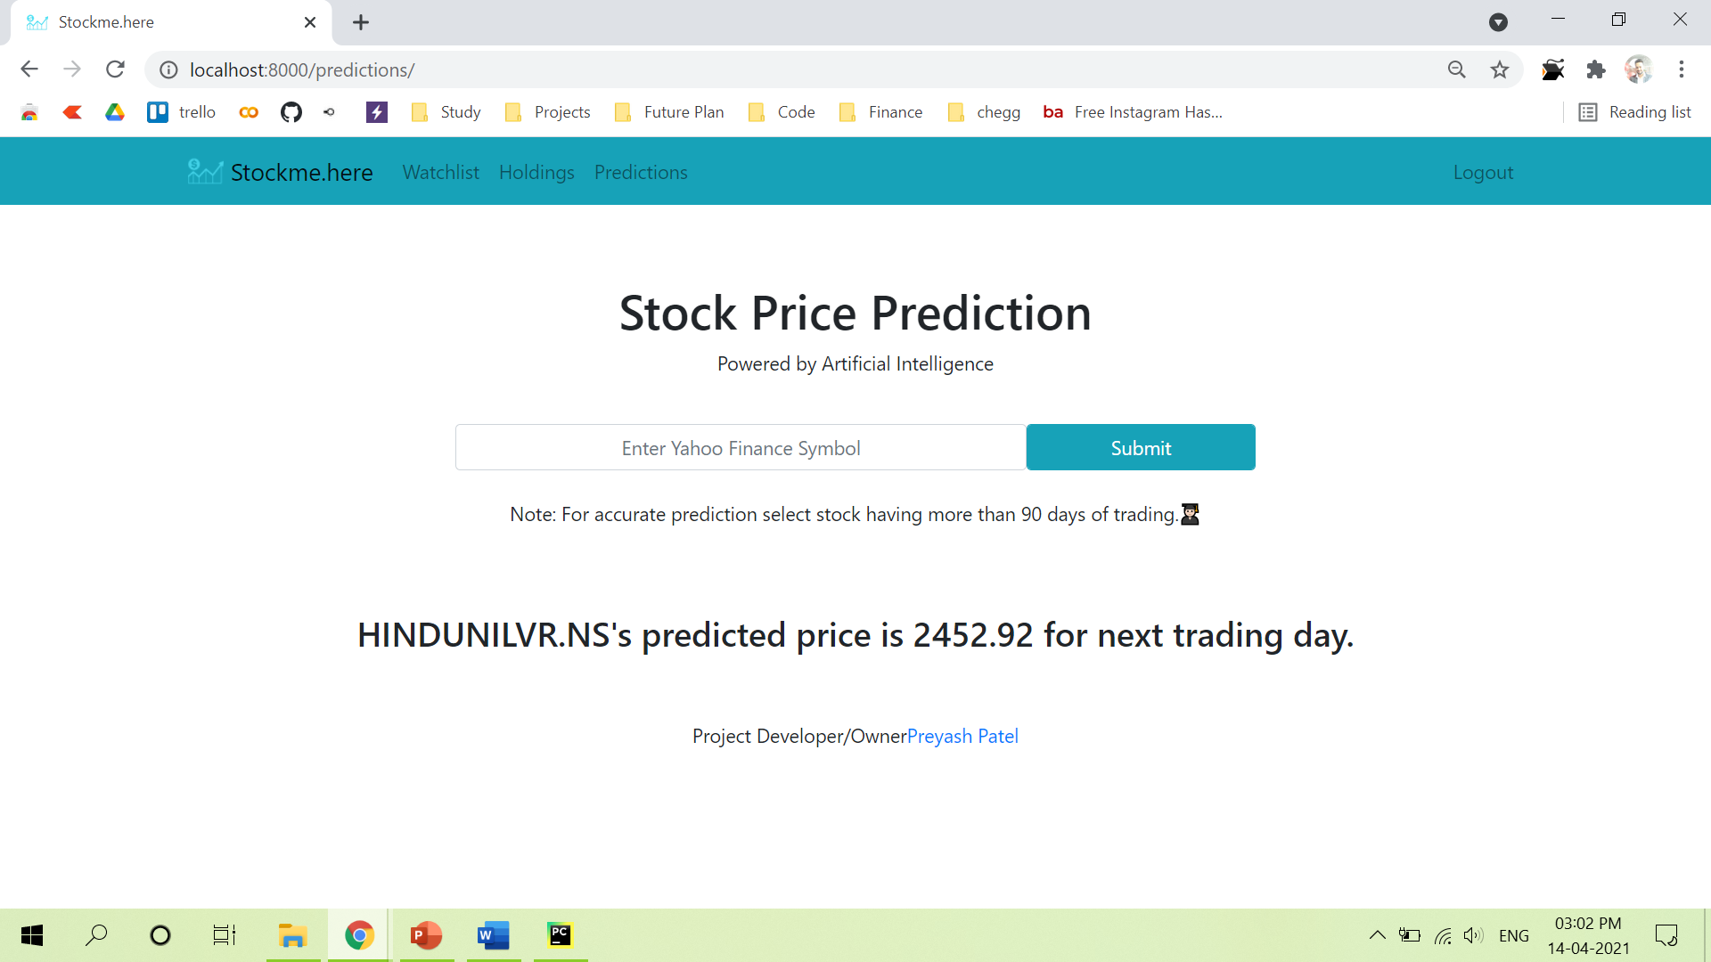
Prediction Page

Slide 45
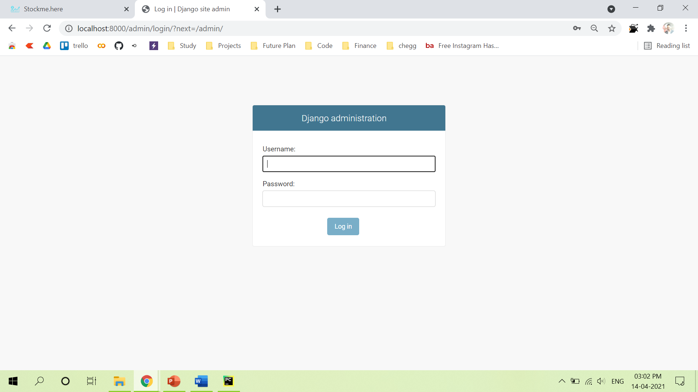
Admin Login Page

Slide 46
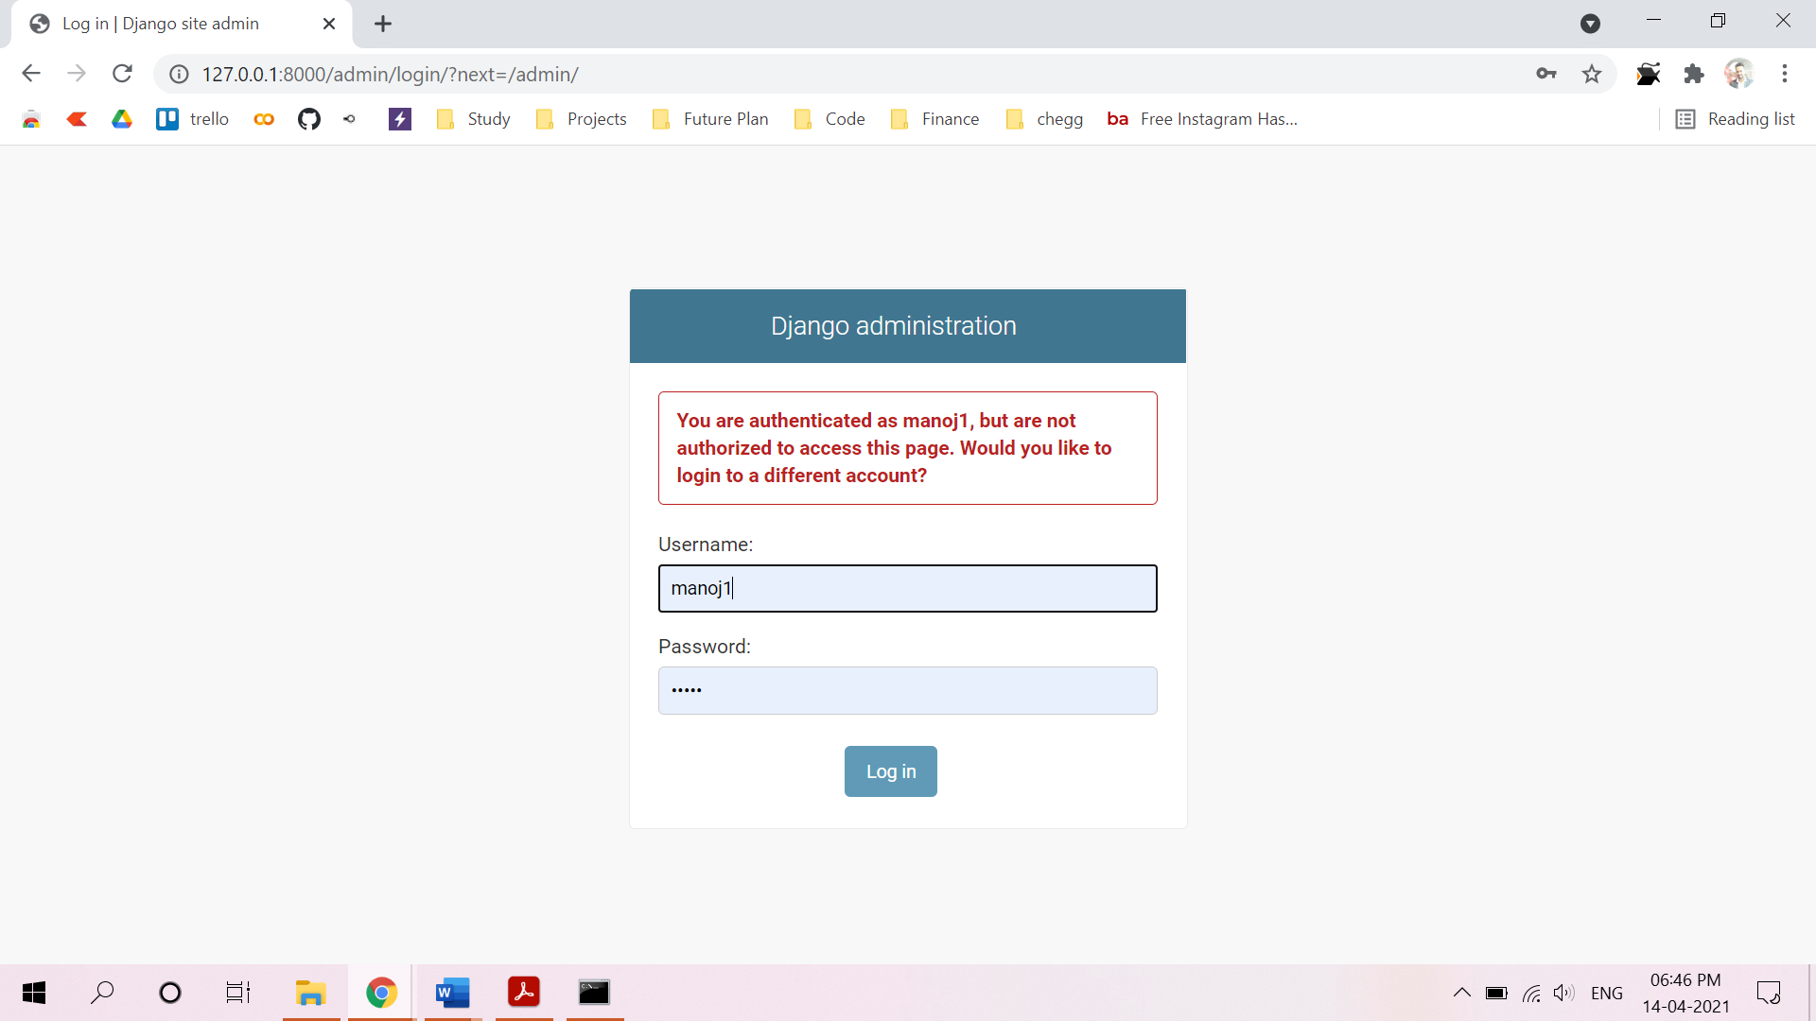
Admin Login Credential Validation:

Slide 47
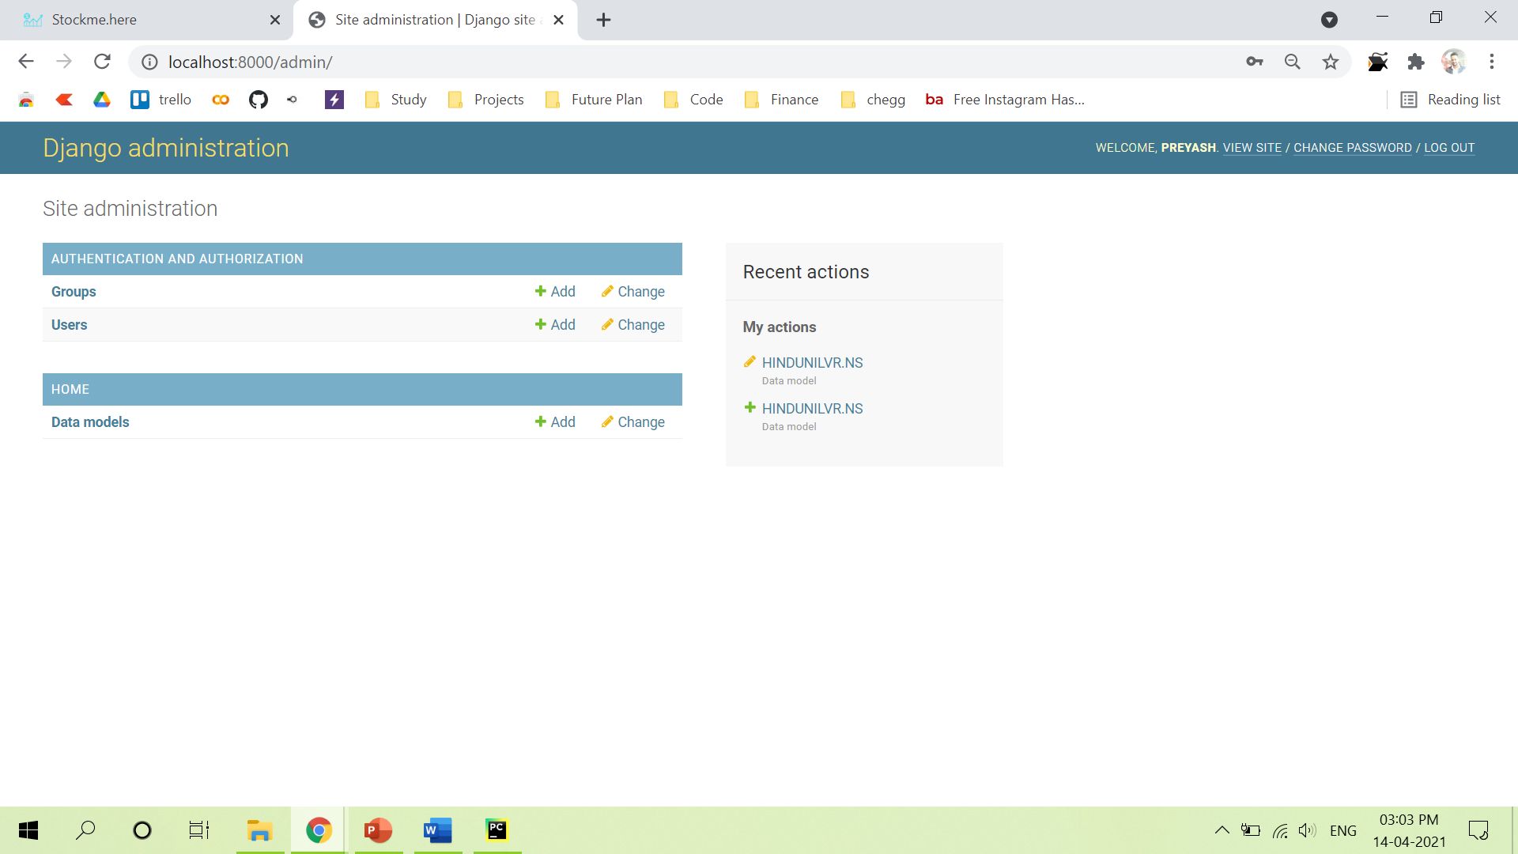
Admin Home Page

Slide 48
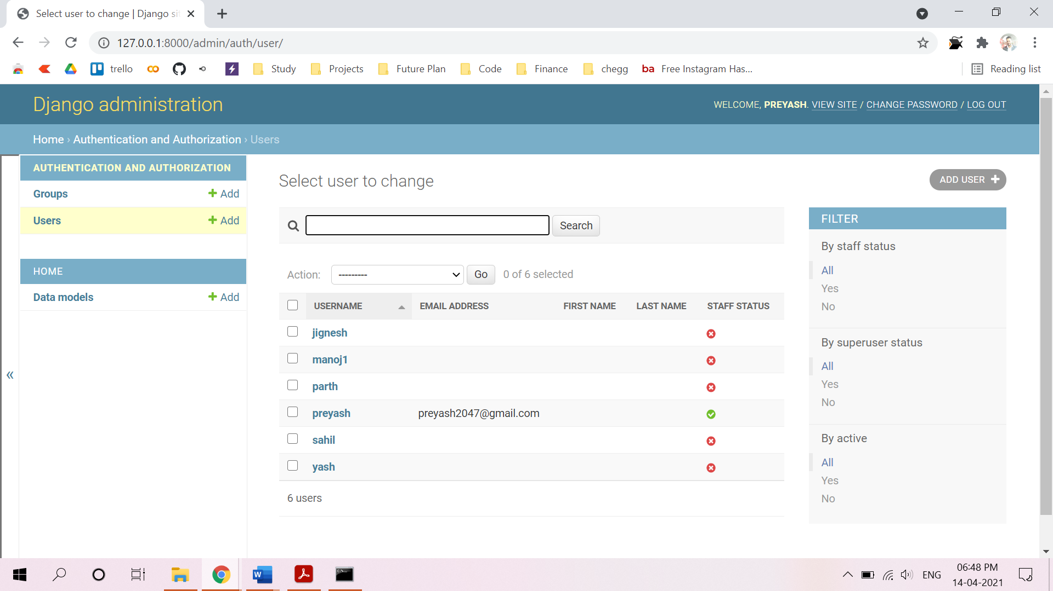
Admin User’s List

Slide 49
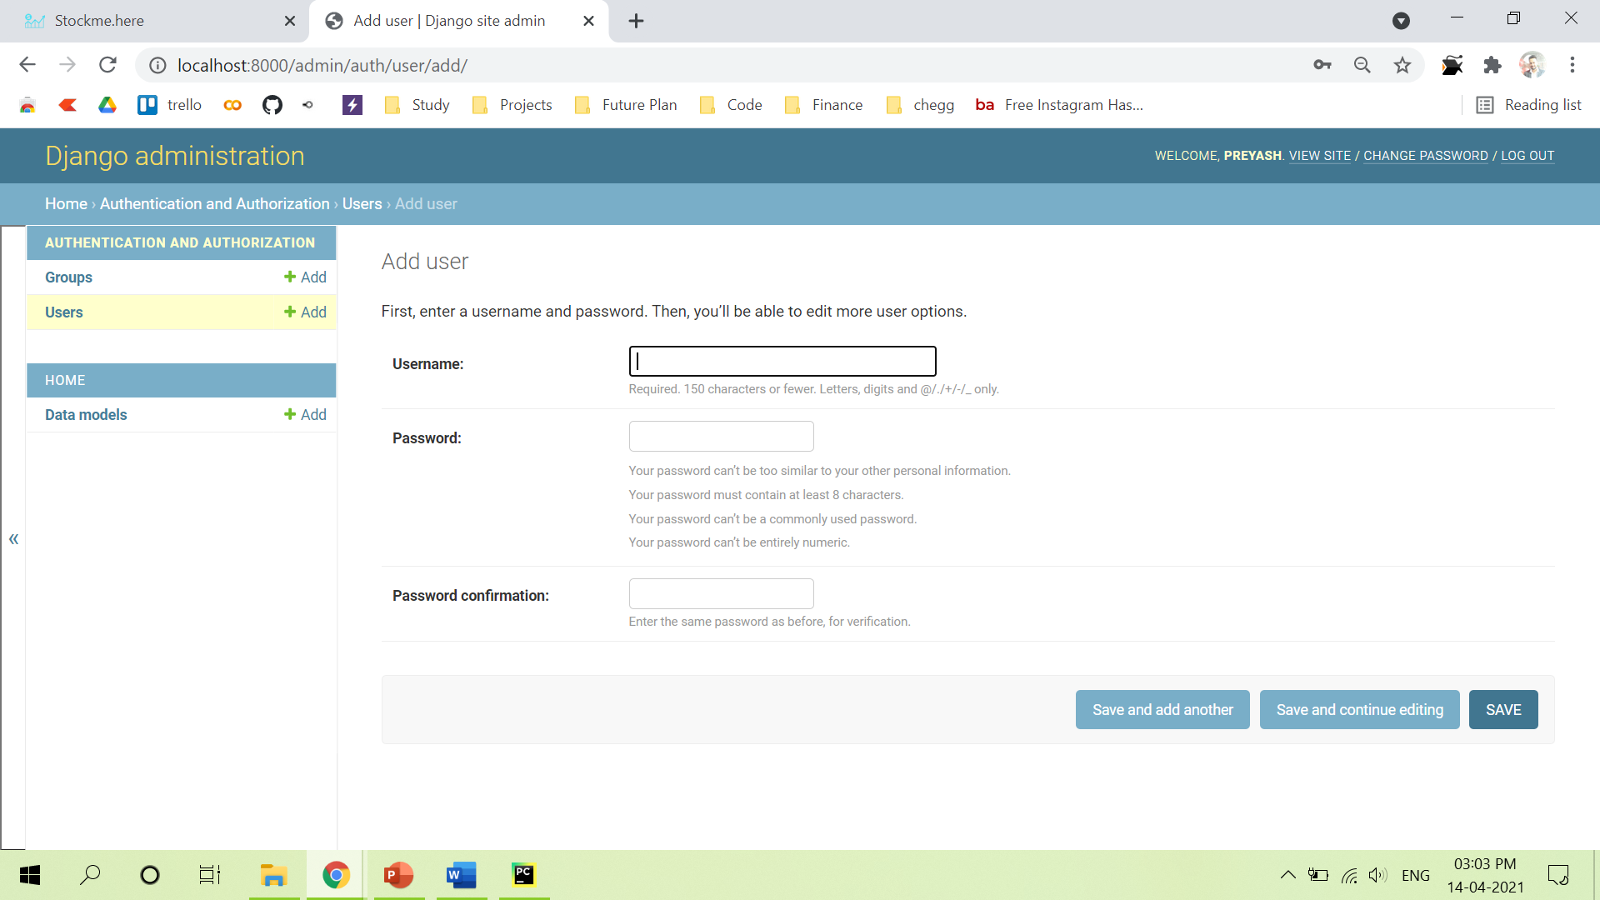
Admin Add User/Super User Page

Slide 50
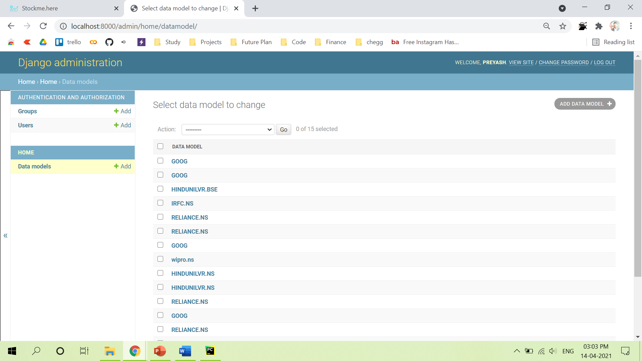
Admin DataModel Page

Slide 51
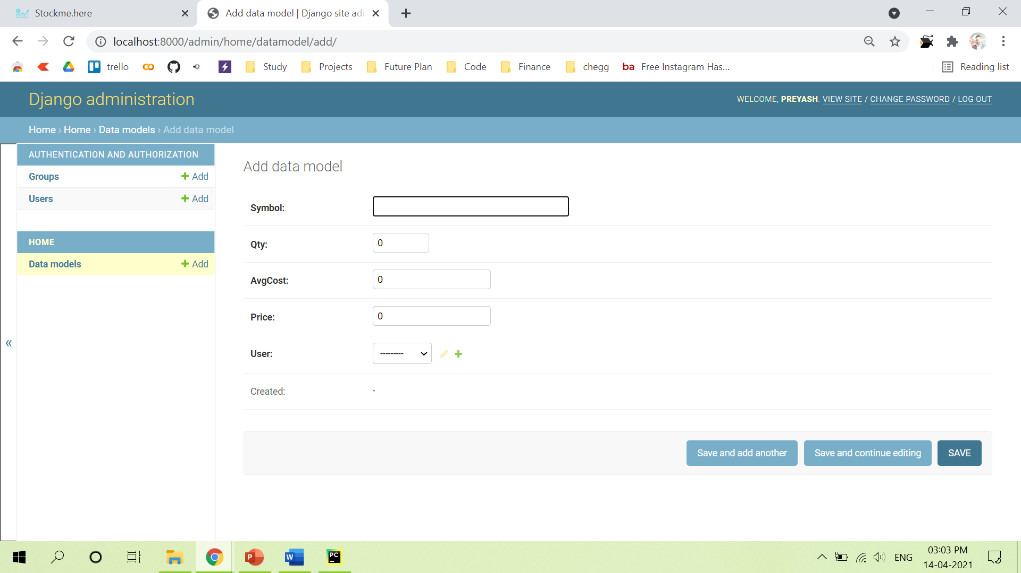
Admin Add DataModel Page

Slide 52
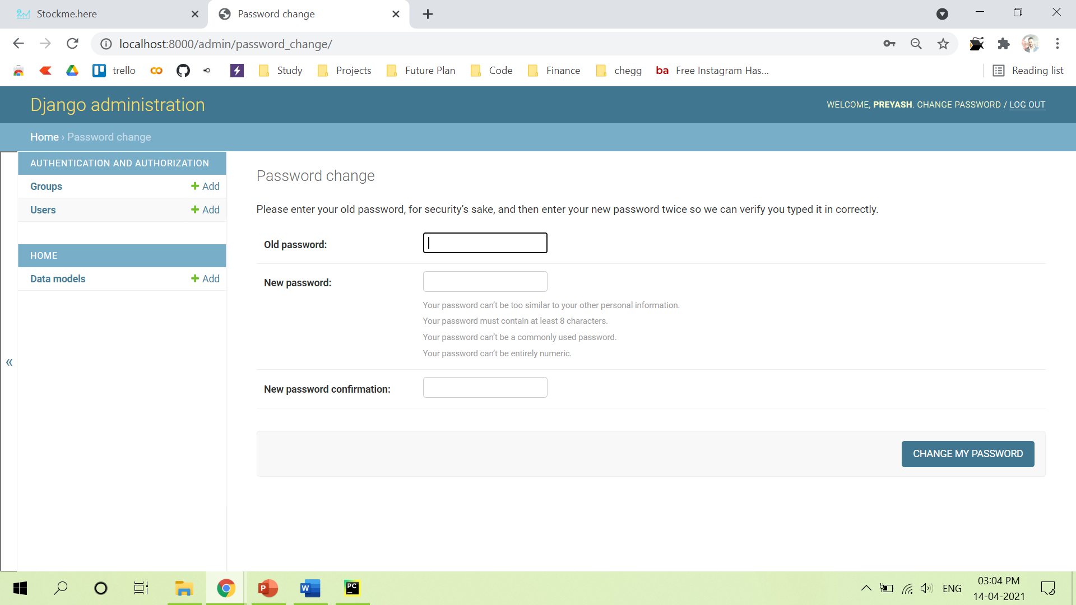
Admin Change Password Page

Slide 53
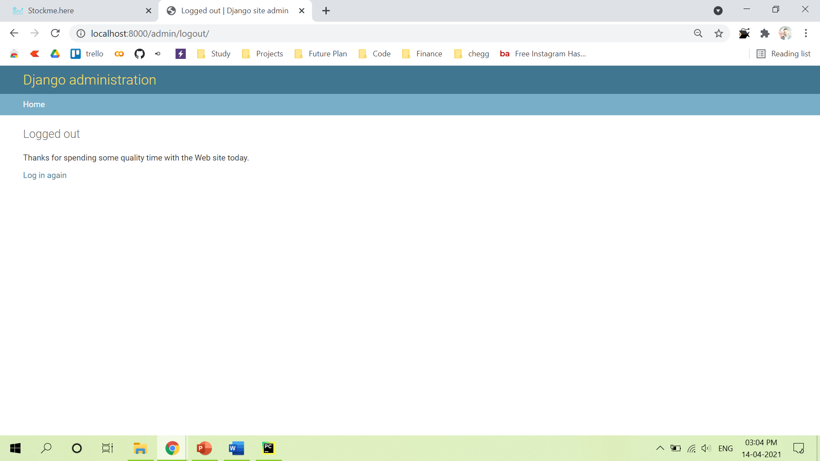
Admin Logout Page

Slide 54
Testing

Slide 55
Testing For Login/Signup Validation
Sr.No | Validation Checking | Excepted Result | Test Result
1 | Usename | Not Null and Unique | Pass
2 | Password | Not null | Pass
3 | Confirm Password | Not null | Pass

Slide 56
Testing For Watchlist
Sr.No | Validation Checking | Excepted Result | Test Result
1 | Symbol | As per Yahoo Finance | Pass

Slide 57
Testing For Holding
Sr.No | Validation Checking | Excepted Result | Test Result
1 | Symbol | As per Yahoo Finance | Pass
2 | Quantity | Greater then Zero | Pass

Slide 58
Testing For Prediction
Sr.No | Validation Checking | Excepted Result | Test Result
1 | Symbol | As per Yahoo Finance | Pass

Slide 59
Future Enhancement

Slide 60
Future Enhancement
Implement NLTK to have impact of News on Stock Price Prediction
Speeding up the Model training time
Maintain prebuilt model for faster response
News update for respective stock
Stock’s Fundamentals view

Slide 61
Bibliography

Slide 62
Bibliography
https://www.djangoproject.com/
https://in.finance.yahoo.com/
https://www.python.org/
http://tensorflow.org/
http://keras.io/

Slide 63
Thank You

